Slide 1

APPLIC
www.applic.cz
Ing. Jiří Čech, Ph.D.
Programmer, R&D
cech@applic.cz
Introduction
Over 30 years experience in industrial automation, measurements and regulation, and machine vision.
Recently finished development of IR cameras and Hyperspectral system.
We offer
We are looking for
1. Custom machine vision solutions
(UV, VIS, NIR, LWIR, Hyperspectral)
2. Electrical design and HW manufacturing
3. SW for system control and evaluation
(Neural networks and FPGA platforms)
4. Fast prototyping
1. Business partners
2. Cooperation on R&D with the newest technologies

Slide 2
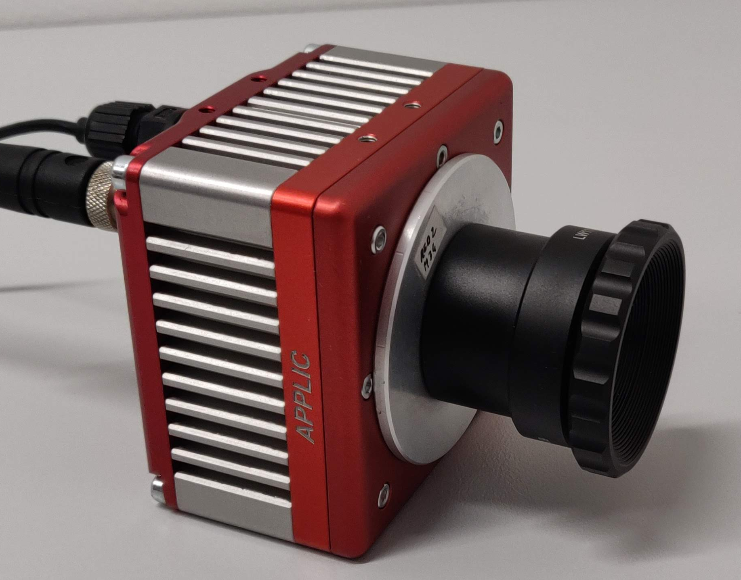
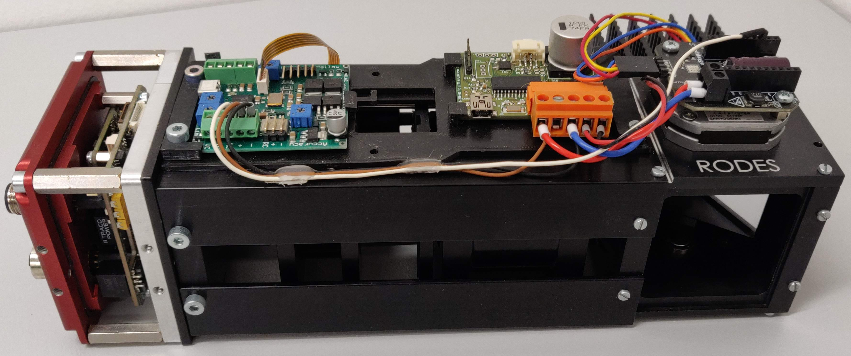
APPLIC
Projects
Hyperspectral LWIR camera RODES
Infrared camera IRCA3

