Slide 1
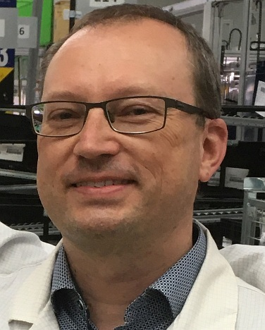
Hella Autotechnik Nova s.r.o.
www.hella.cz
Martin Kutáč
Head of Development – Lighting Technology
martin.kutac@forvia.com
Introduction
HELLA enjoys a uniquely favorable technical position, since both the lighting and electronics segments are combined under one roof.
HELLA is a technological leader, and has been responsible for launching many innovative series products, such as the first full LED headlamp or the world’s first headlamp with glare-free high beam.
Light is essential to both seeing and being seen. Since vehicle lighting is so important to the safety of everyone on the road, HELLA develops innovative lighting systems that offer a high level of driving comfort while also providing optimum illumination of the road ahead.

Slide 2
Hella Autotechnik Nova s.r.o.
www.hella.cz
Martin Kutáč
Head of Development – Lighting Technology
martin.kutac@forvia.com
We offer
We are looking for
Main areas of research and development:
Image processing, Quality control automatization
Optical systems improved in term of effectivity and size reduction
Innovative light sources
Electronic control units
Partners in all area of our R&D activities
Suppliers
Technology institutes
Universities

Slide 3
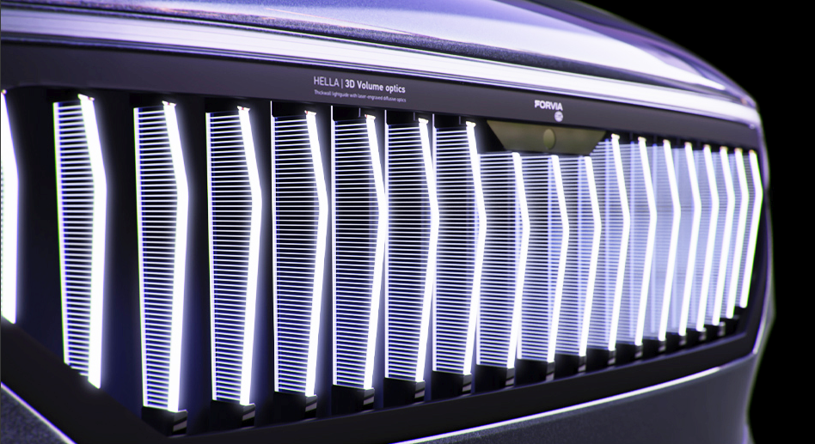
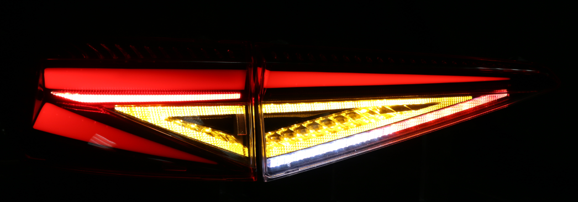
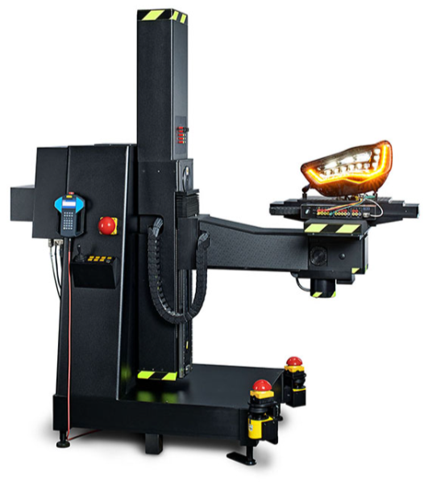
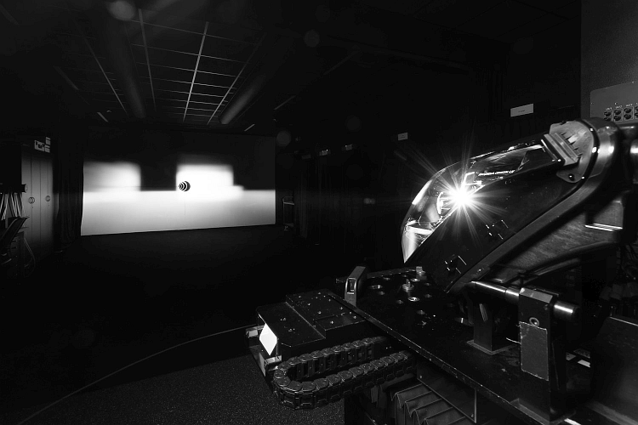
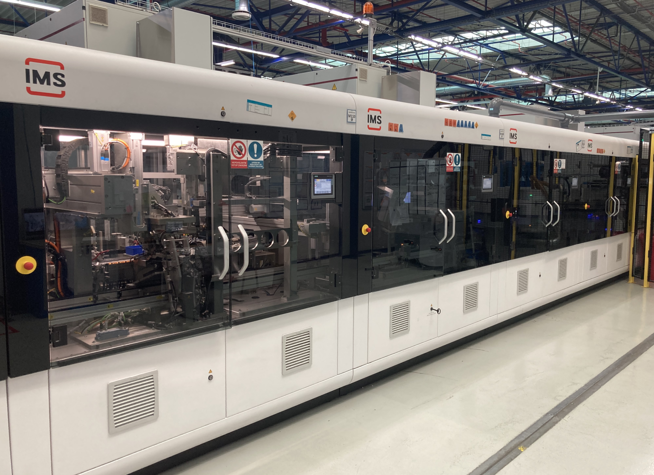
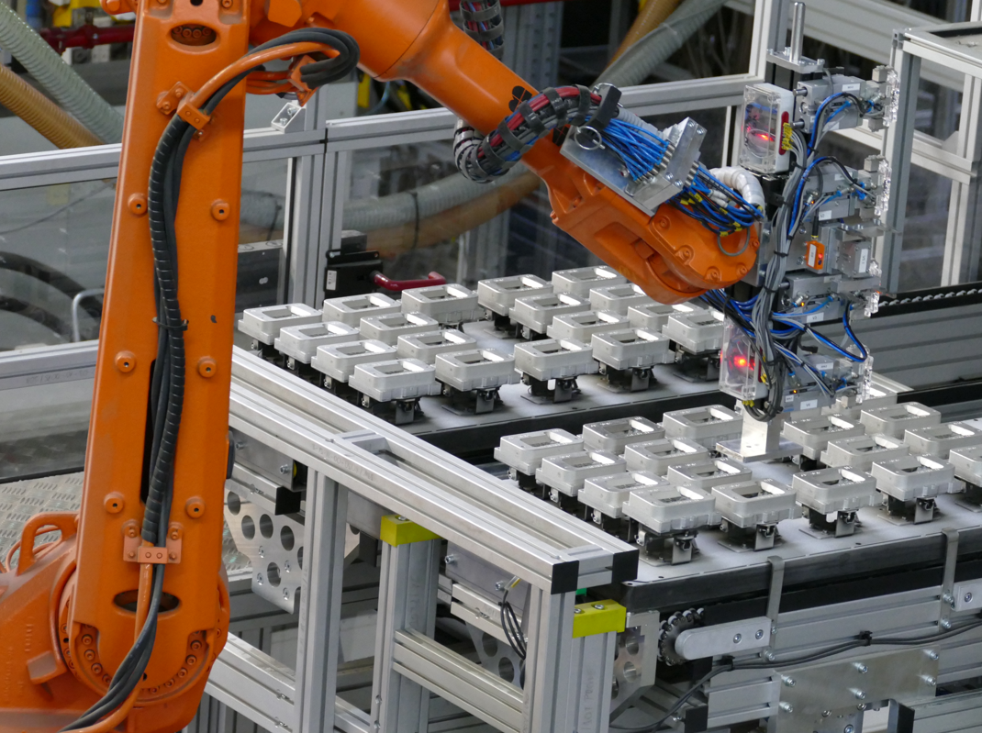
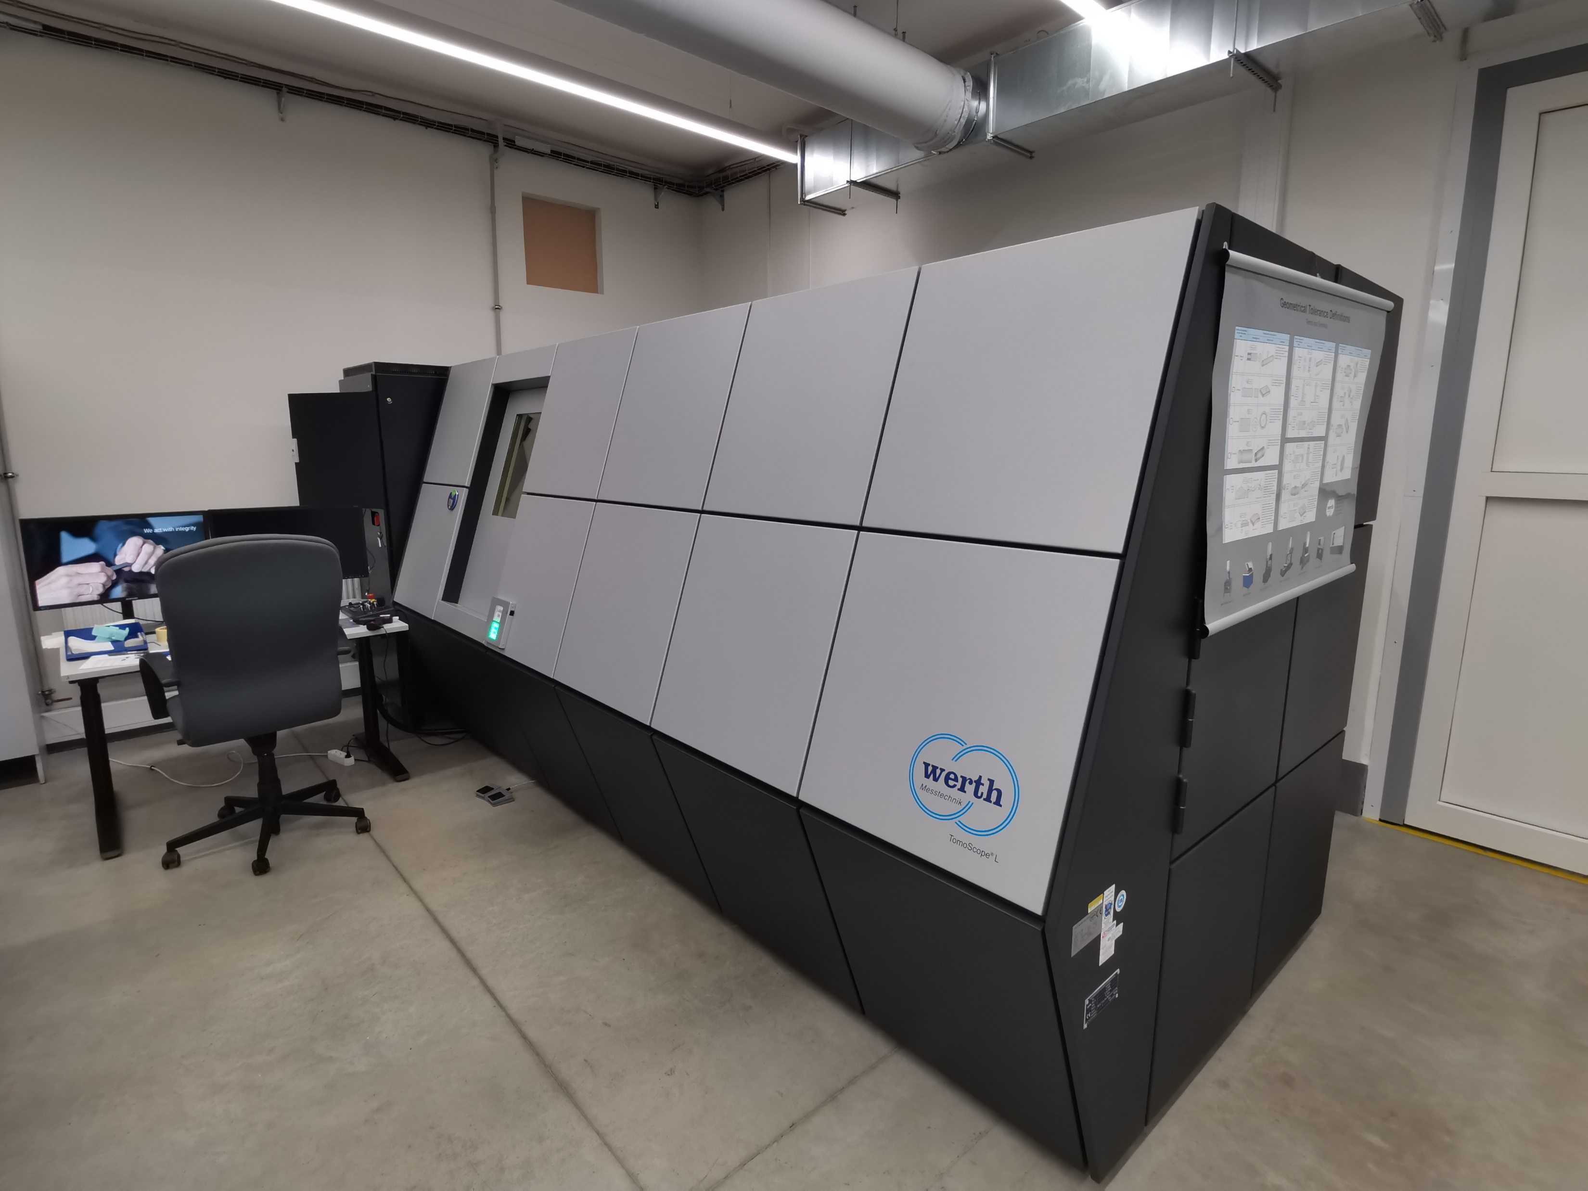
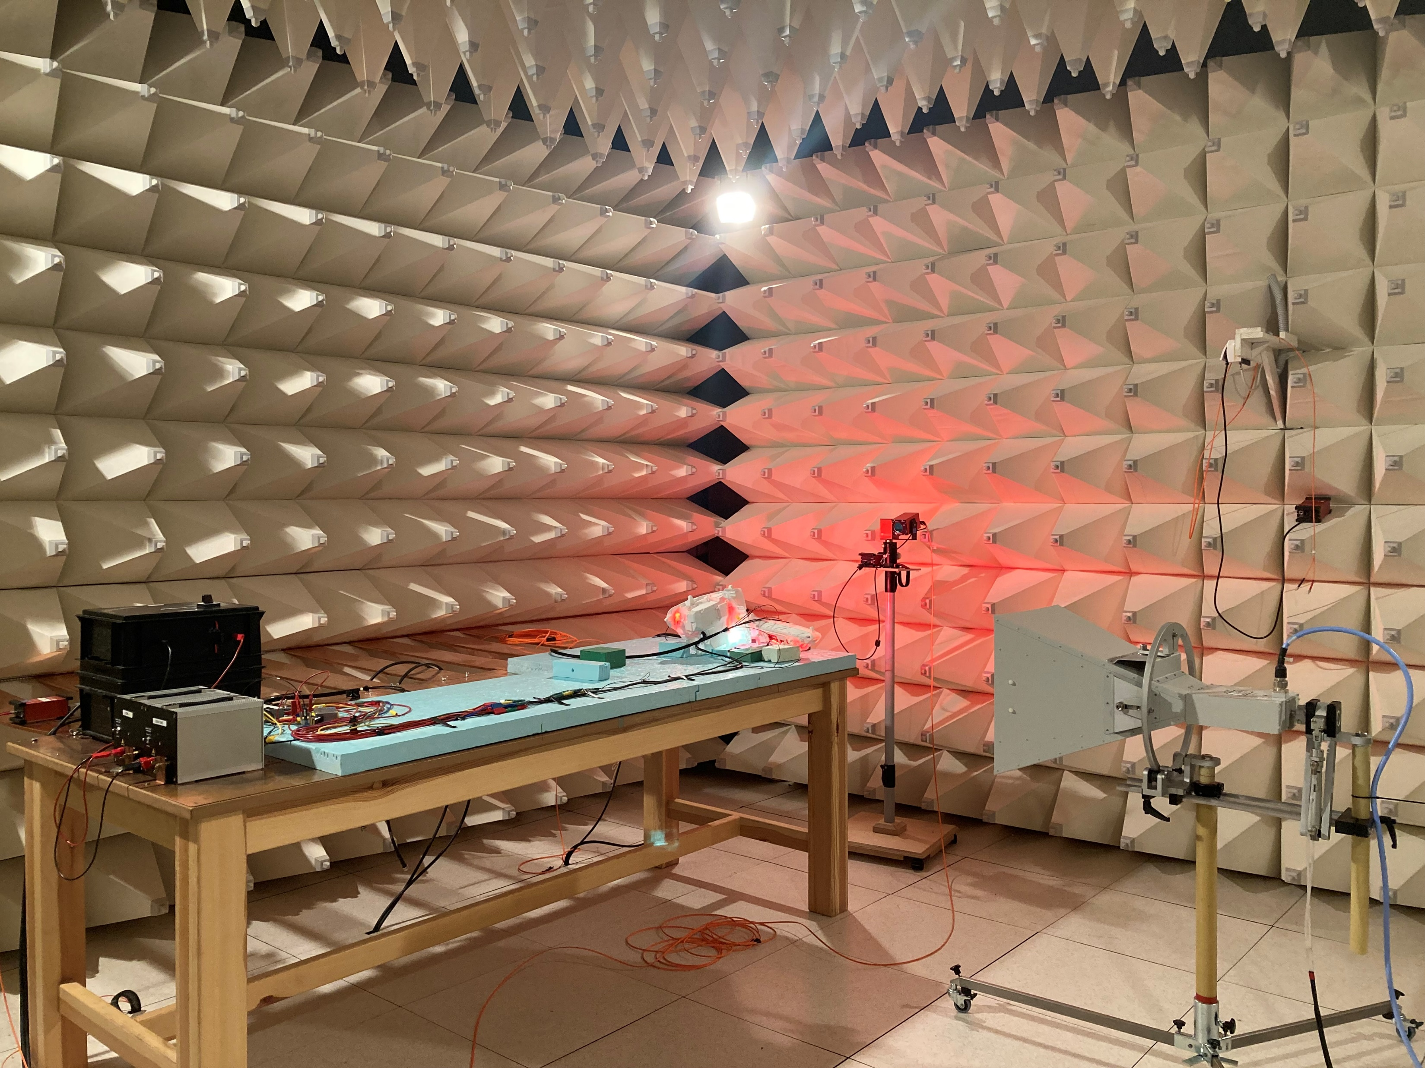
Hella Autotechnik Nova s.r.o.
Pictures

