Slide 1
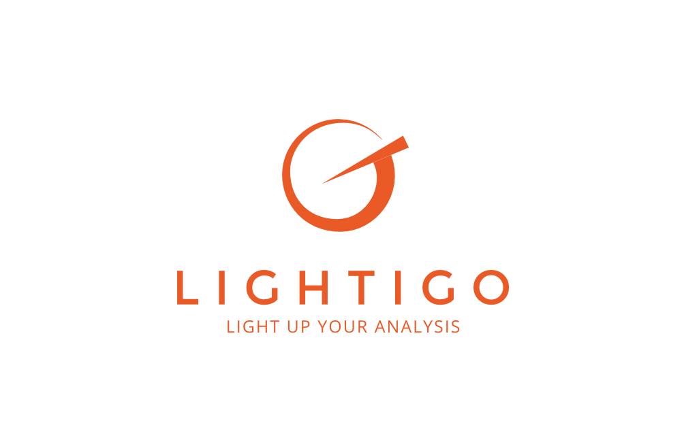
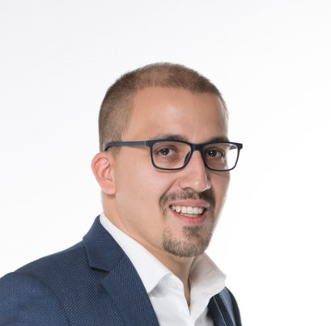
Lightigo s.r.o.
www.lightigo.com
Marek Rozehnal
CEO
rozehnal@lightigo.com
Introduction:
Lightigo is a supplier of solutions for chemical analysis using laser spectroscopy – LIBS „Laser Induced Breakdown Spectroscopy“.
The core product „FireFly“ is a laboratory instrument specialized in rapid multi-elemental chemical imaging of solid samples of various types with an emphasis on high performance, stability, and user experience.
FAST | MULTI–ELEMENTAL | NON-CONTACT | NO SAMPLE PREPARATION | SENSITIVITY TO LIGHT ELEMENTS
DEPTH PROFILING

Slide 2
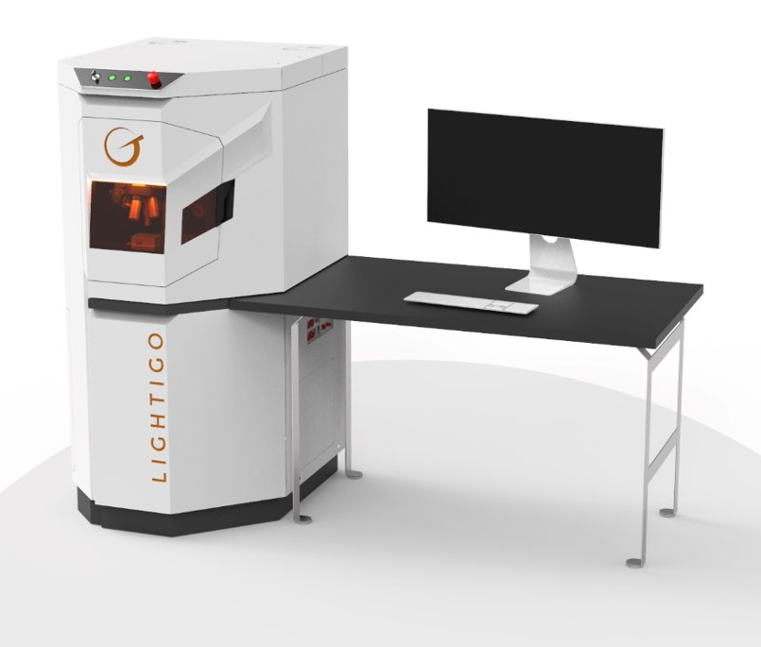
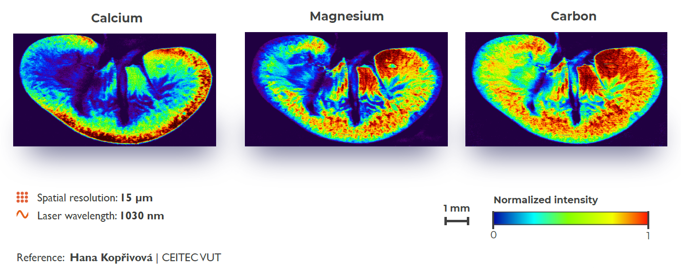
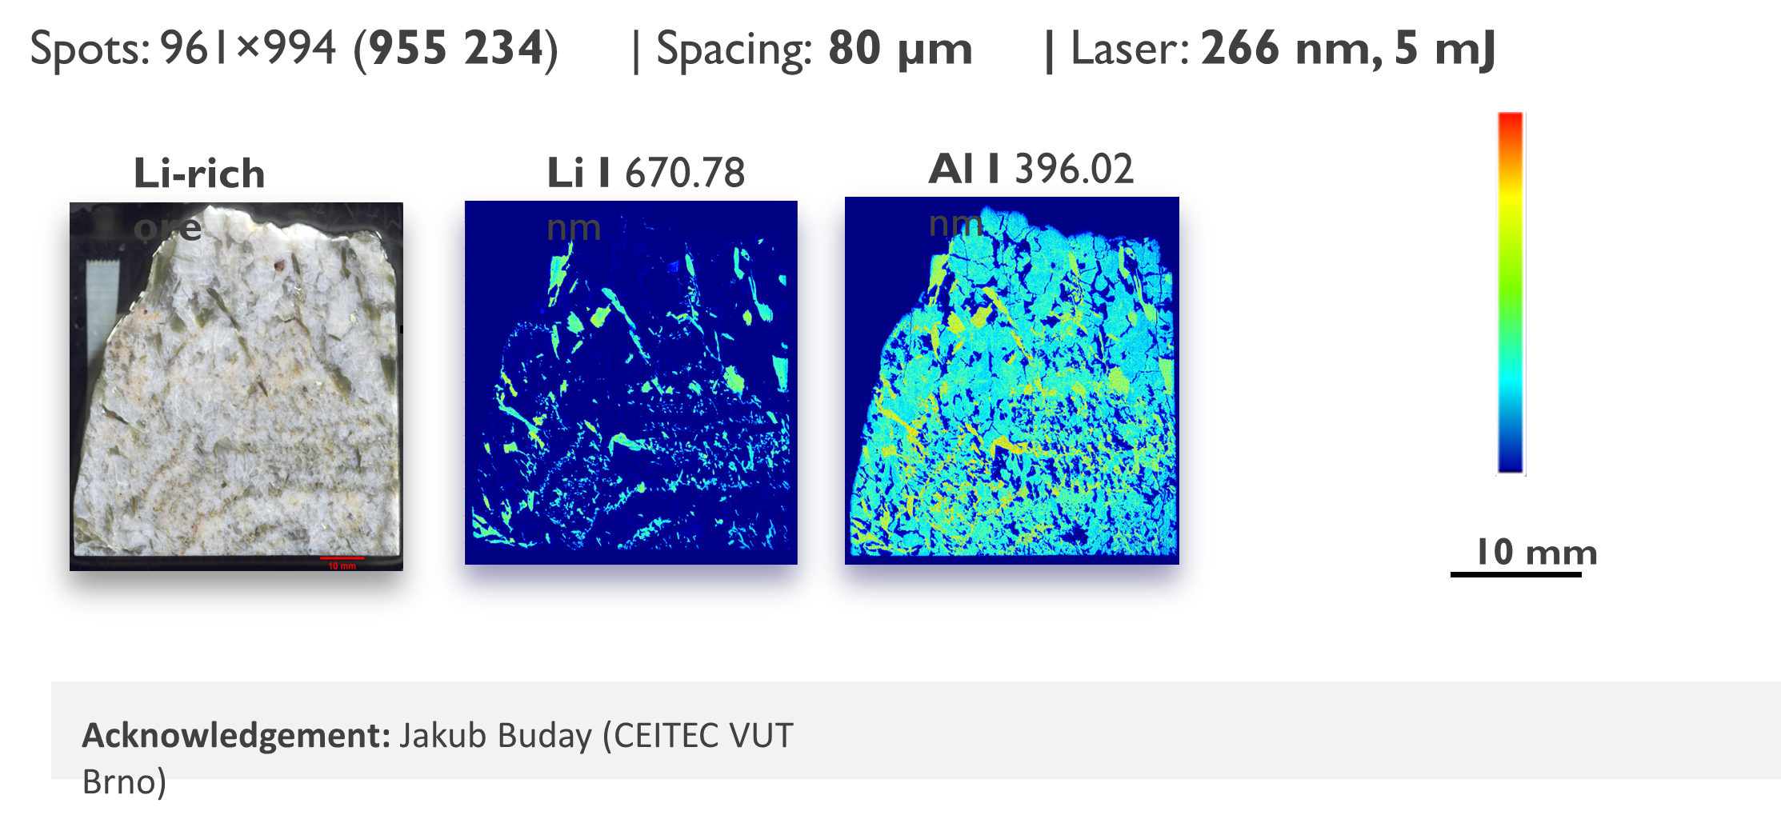
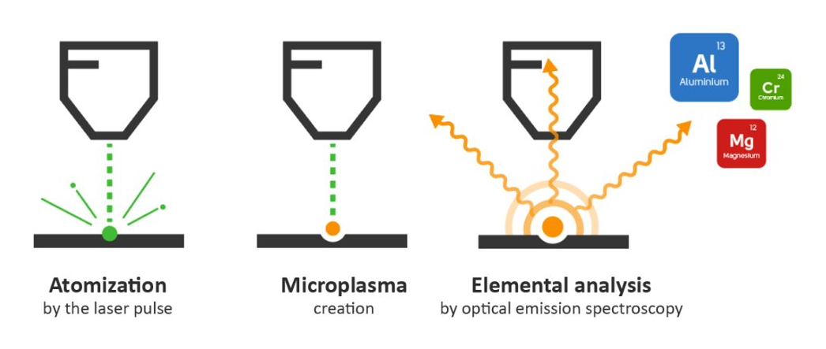
Lightigo s.r.o.

Slide 3

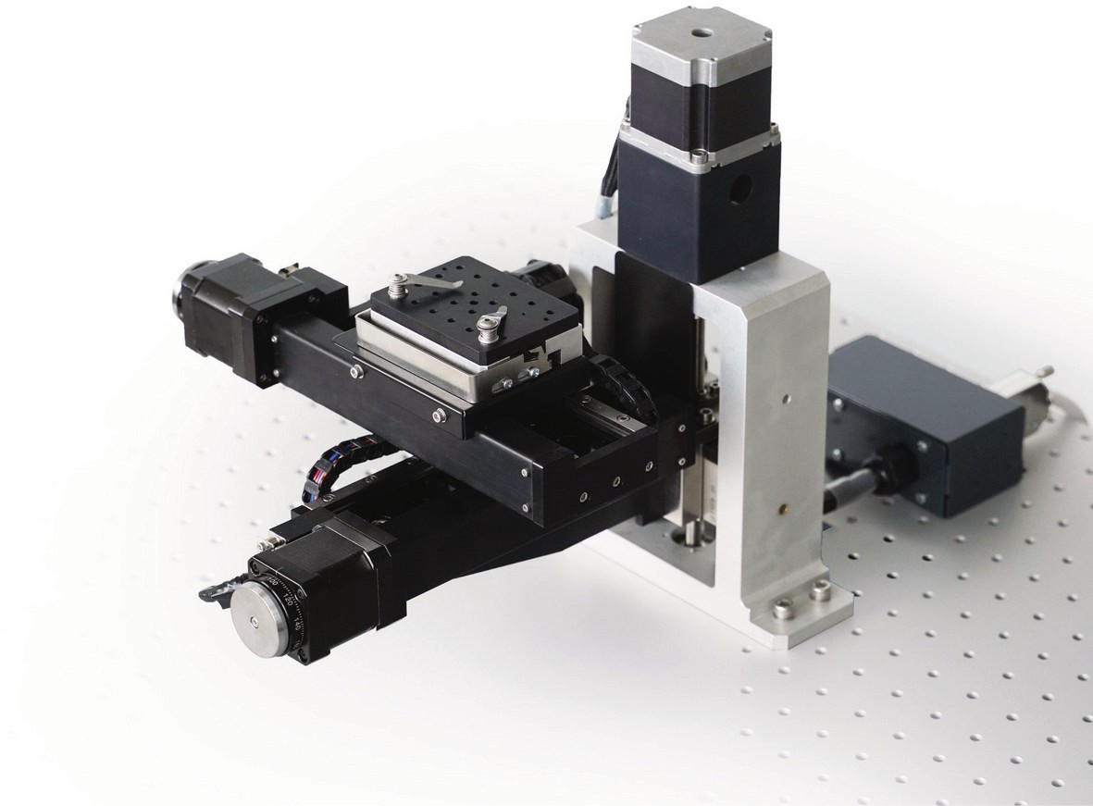
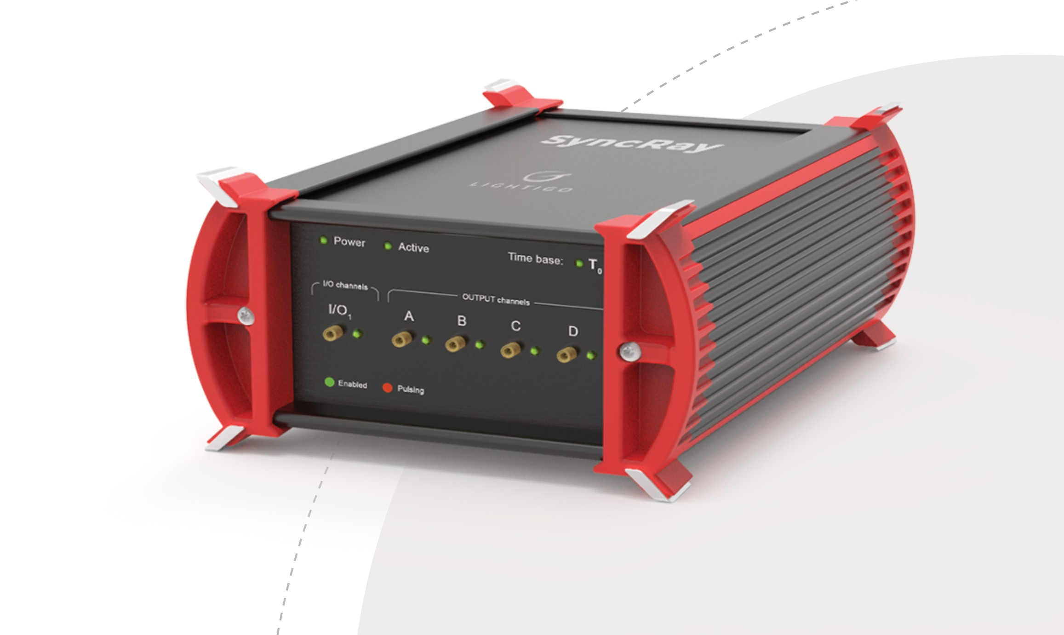
We are looking for:
Distributors
Sales opportunities
R&D collaboration
What we offer:
Solution for multielemental analysis – FireFly
Delay generator – SyncRay
3-axis stage – MC 100
Consulting in the field of LIBS
Custom development

