Slide 1
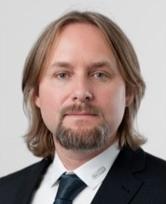
TELIGHT Holding s.r.o.
www.telight.eu
Vojtěch Sanetrník
Chief Operations Officer
vojtech.sanetrnik@telight.eu
Introduction
TELIGHT specializes in the development of light optics instruments for life sciences. It offers innovative solutions for research centers, laboratories, and universities worldwide. Their mission is to provide researchers with the most advanced equipment for their work, a researcher is always at the center of their endeavor. Their specialization lies in the long-term imaging of live cells.

Slide 2
TELIGHT Holding s.r.o.
www.telight.eu
Vojěch Sanetrník
Chief Operations Officer
vojtech.sanetrnik@telight.eu
We offer
We are looking for
TELIGHT`s core competencies are:
Development and production of light microscopy solutions for life-science applications
Software development for living-cell analysis
Scientific applications support
SALES OPPORTUNITIES
(To discover and exploit the particular sales opportunities.)
R&D COLLABORATION
(To improve conditions for R&D activities, to find suitable strategic ways of R&D collaboration.)

Slide 3
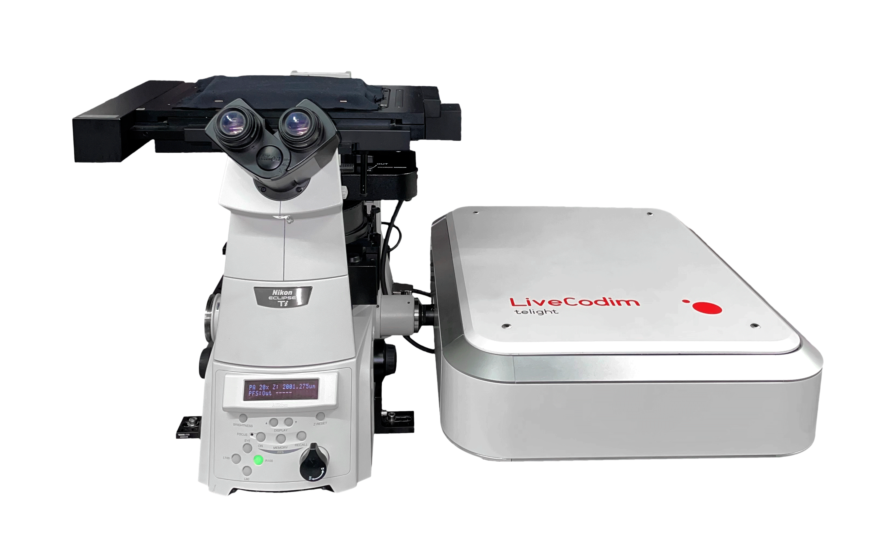
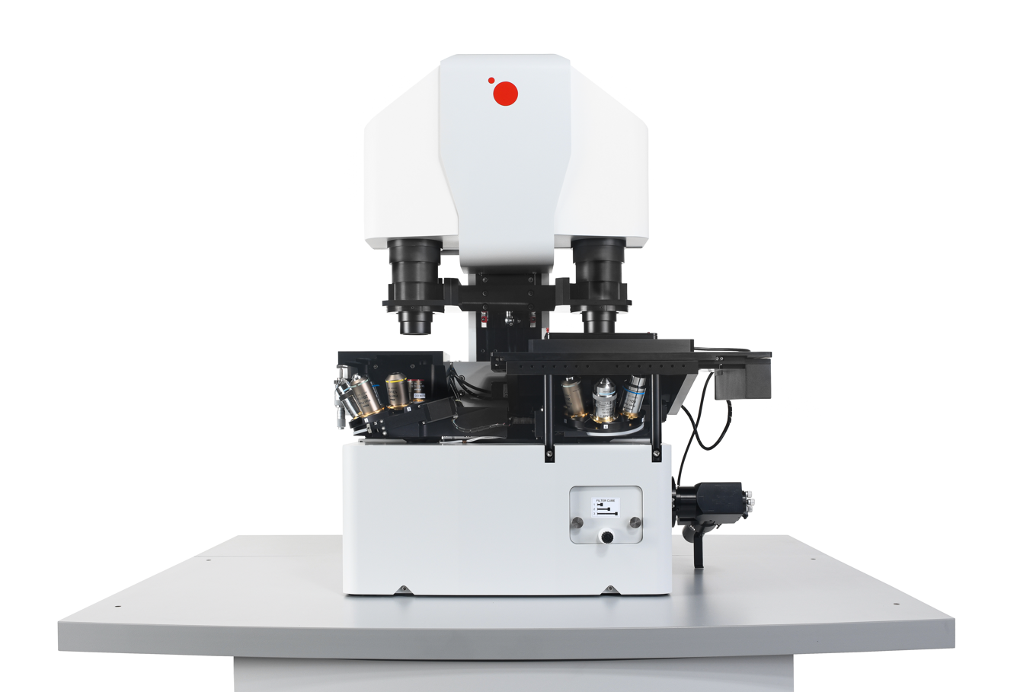
TELIGHT Holding s.r.o.
Pictures

