Slide 1


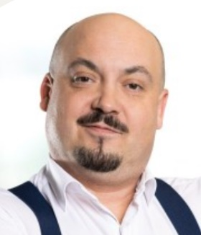


ZKW Automotive Engineering CZ s.r.o.
http://www.zkw-group.com/cz/
David Pala
Managing Director
david.pala@zkw-group.com
Milan Křižák
Regulatory & Type Approval Affairs, COC rep.
milan.krizak@zkw-group.com
Introduction
The ZKW company was est. 1938. Since 2018 is a member of the LG Group.
Czech Republic site est. 2021, full product development capability, >70 employees.
ZKW's pioneering premium lighting and electronics systems for all mobility concepts in the global automotive industry.

Slide 2
ZKW Automotive Engineering CZ s.r.o.
http://www.zkw-group.com/cz/
Milan Křižák
Regulatory & Type Approval Affairs, COC rep.
milan.krizak@zkw-group.com
We offer
We are looking for
Automotive exterior lighting expertise
Synergies, to promote the importance of the field of automotive optics, especially but not only in the North Moravian region, and to direct and encourage young people to study related fields of expertise
Practical approach for digital company
R&D cooperation - Partners helping us discover and implement new unique efficient, attractive or low-cost exterior lighting solutions of our products
Universities cooperation
Laboratories for testing purposes

Slide 3
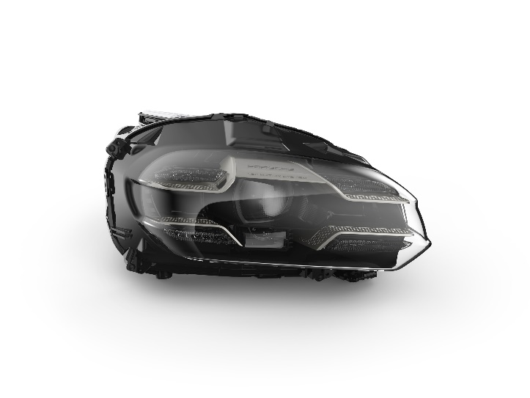
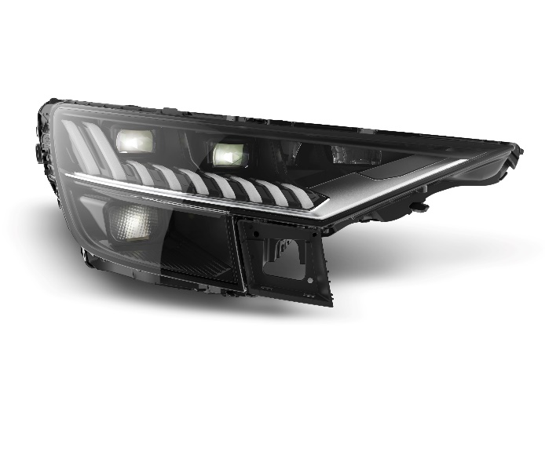
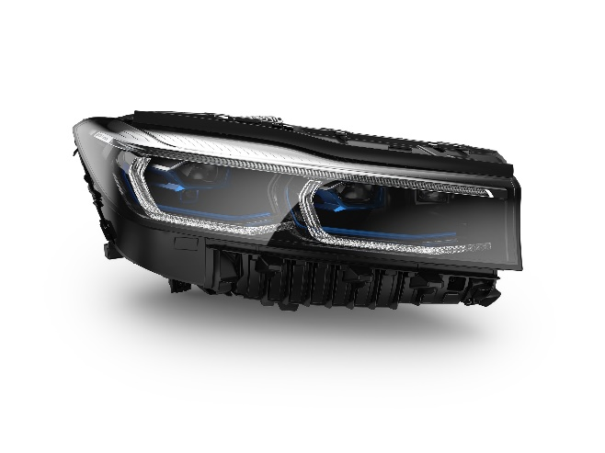
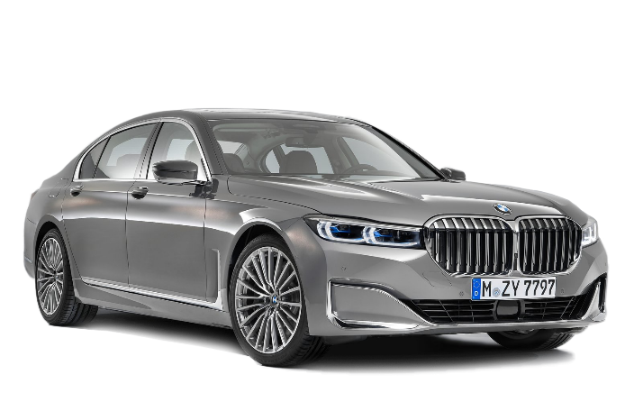
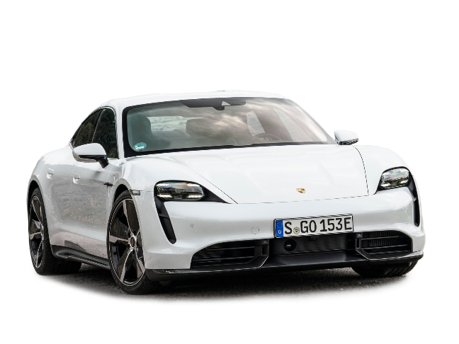
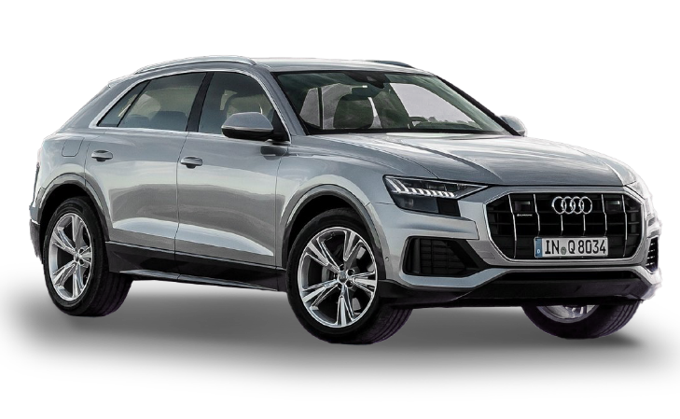



ZKW Automotive Engineering CZ s.r.o.
Products I premium quality for greater road safety
BMW 7er
Porsche Taycan
Audi Q8

Slide 4
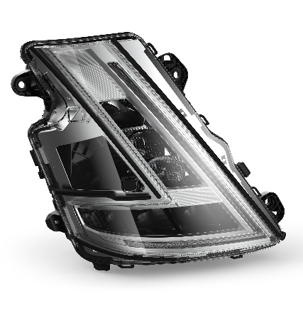
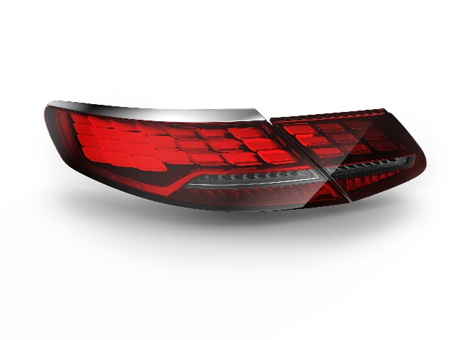
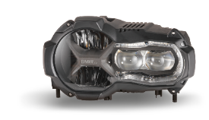
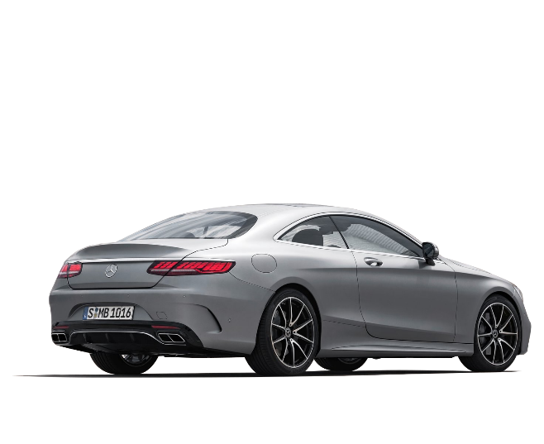
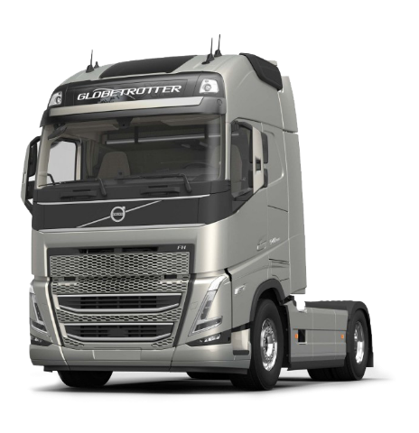
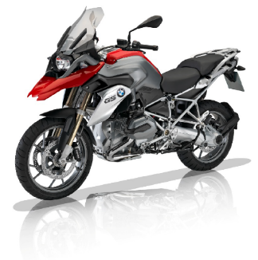


ZKW Automotive Engineering CZ s.r.o.
Products I premium quality for greater road safety
Volvo Trucks FH
BMW Motorrad K50
Mercedes-Benz S-Class Coupe

Slide 5
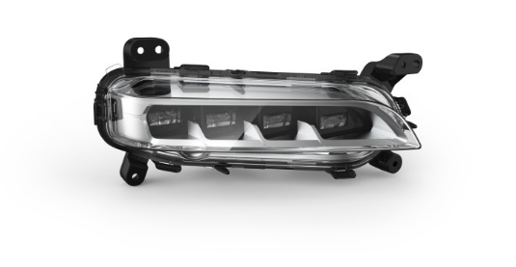
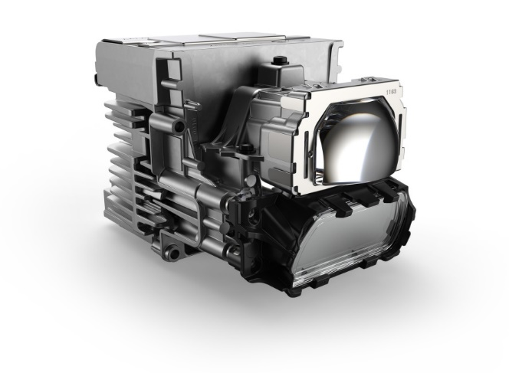
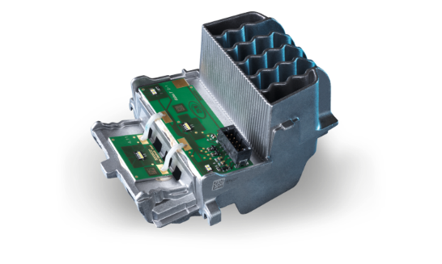
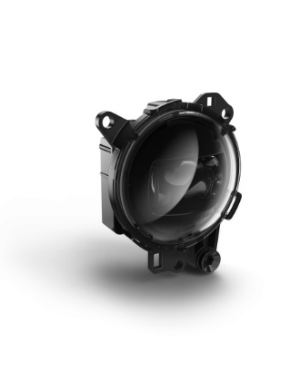
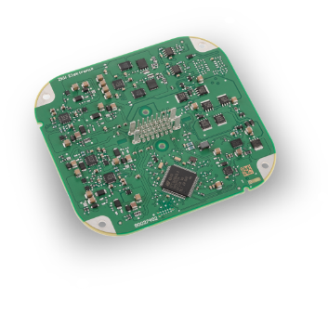
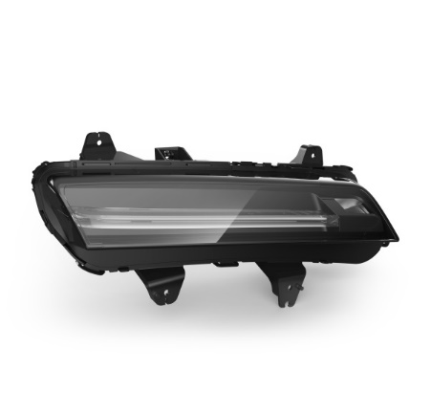
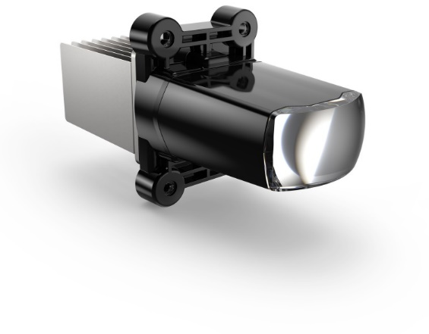
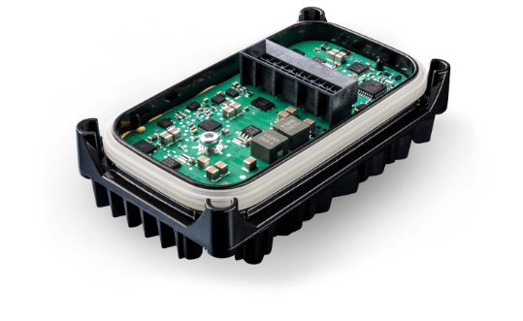
ZKW Automotive Engineering CZ s.r.o.
Products I premium quality for greater road safety
Auxiliary lamps
Modules
ECUs

