Slide 1


Łukasiewicz – Institute of Microelectronics and Photonics
IMiF.lukasiewicz.gov.pl
Piotr J. Cywiński
Head of Commercialization and Sales
piotr.cywinski@imif.lukasiewicz.gov.pl
Introduction
Łukasiewicz - Institute of Microelectronics and Photonics undertakes R&D activities in in micro- and nanoelectronics, optoelectronics, materials science, photonics (including nanophotonics), flexible electronics, microwave electronics, and power electronics.
We design, develop and manufacture micro- and optoelectronic semiconductor devices, including microwave and photonic discrete devices, detectors, actuators, integrated circuits, micro-systems and electronic components, microelectronic industrial devices, power devices, diffractive elements.
design and develop new materialsGraphene, and composite ceramics; and test and control their properties in the view of industrial mass production.

Slide 2
Łukasiewicz – Institute of Microelectronics and Photonics
IMiF.lukasiewicz.gov.pl
Piotr J. Cywiński
Head of Commercialization and Sales
piotr.cywinski@imif.lukasiewicz.gov.pl
We offer
We are looking for
Łukasiewicz-IMIF in mainly acitve in these fields:
MATERIAL SCIENCE (Graphene, Metal Sinters, Luminophore Powders)
PHOTONICS (Optical Fibers, Quantum Cascade Lasers)
MICROELECTRONICS (GaN, Si and SiC technologies, LTCC, Flexible electronics)
1. R&D COLLABORATION
To improve quality of R&D activities
To foster POL-CZE cooperation
To generate new products sought on the market
2. SALES OPPORTUNITIES
To exploit opportunities associated with the technologies, products and services
offered by Łukasiewicz IMIF

Slide 3
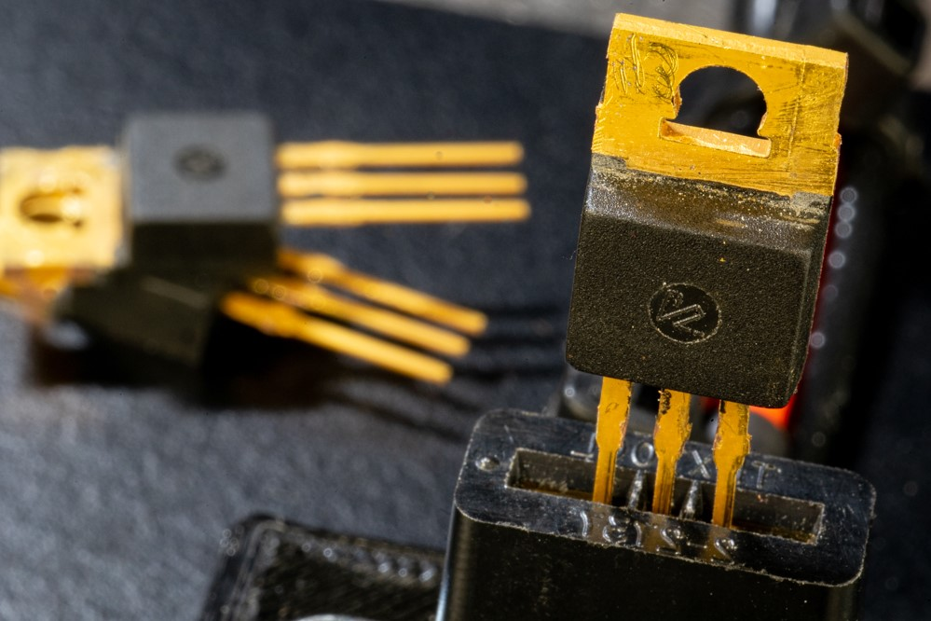
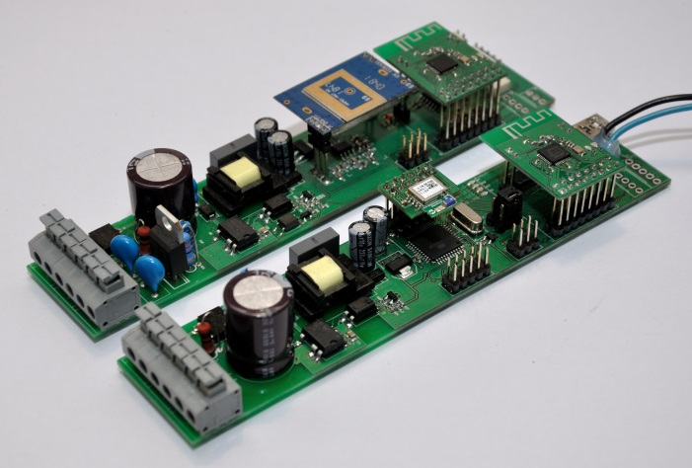
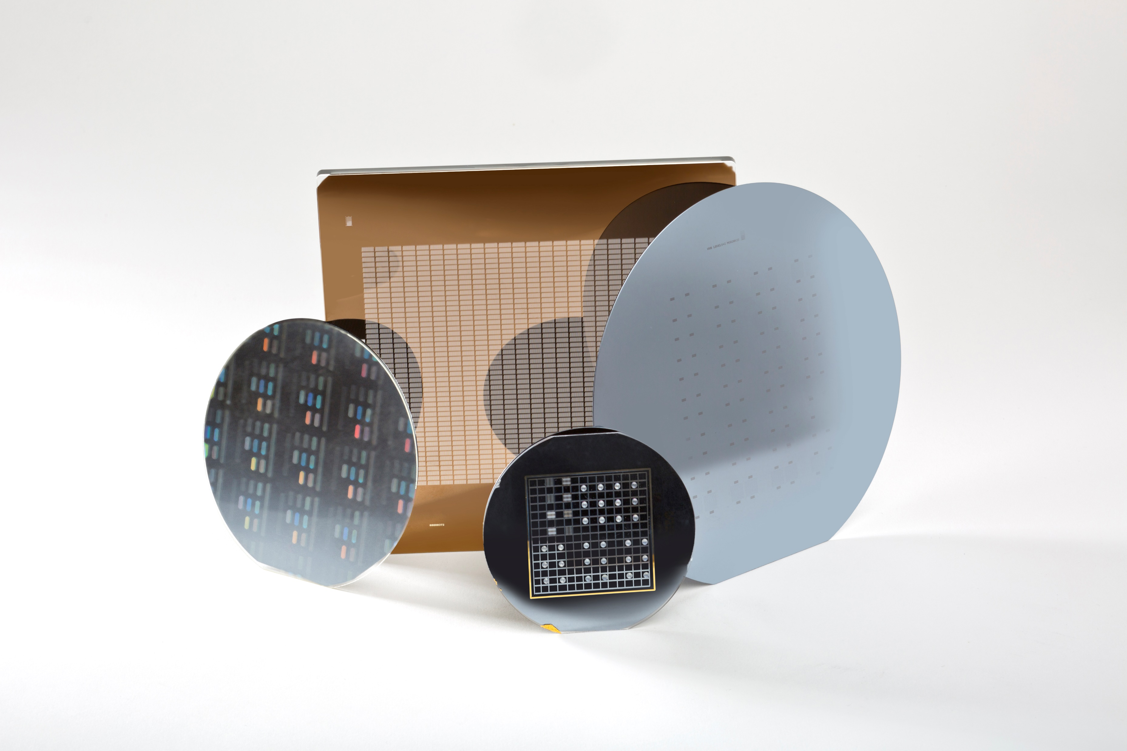
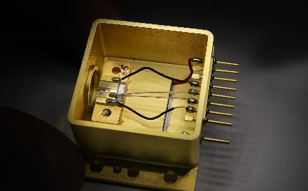
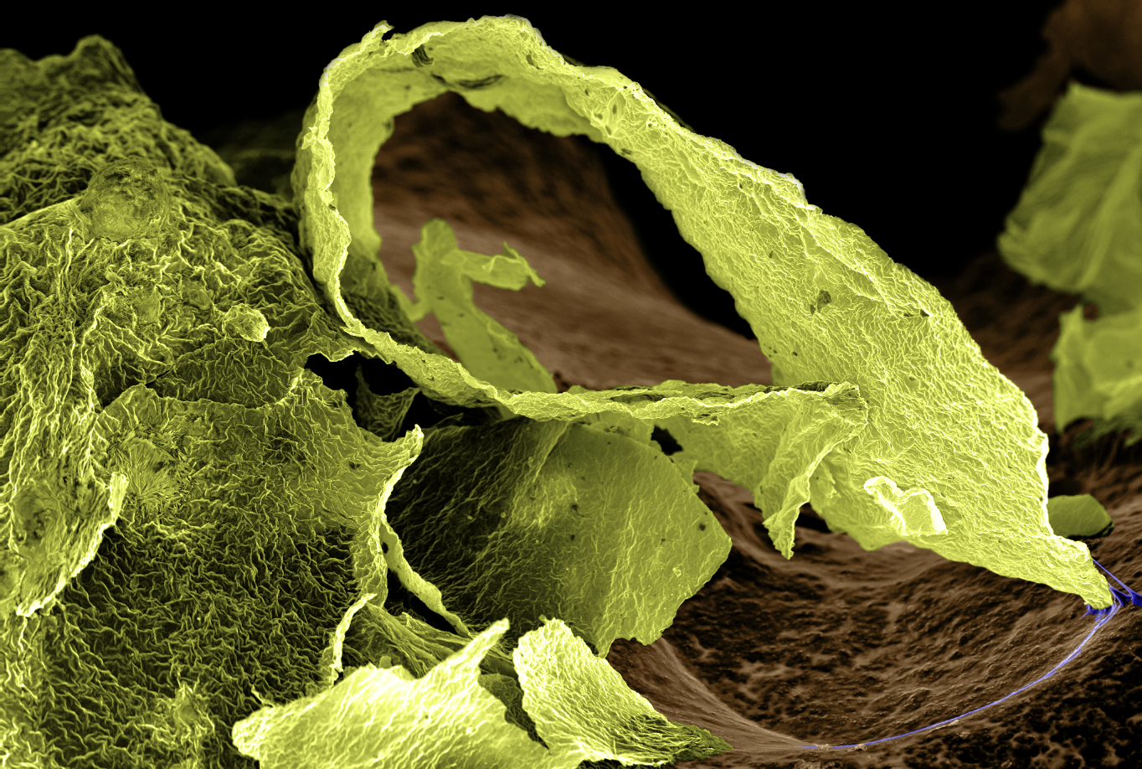
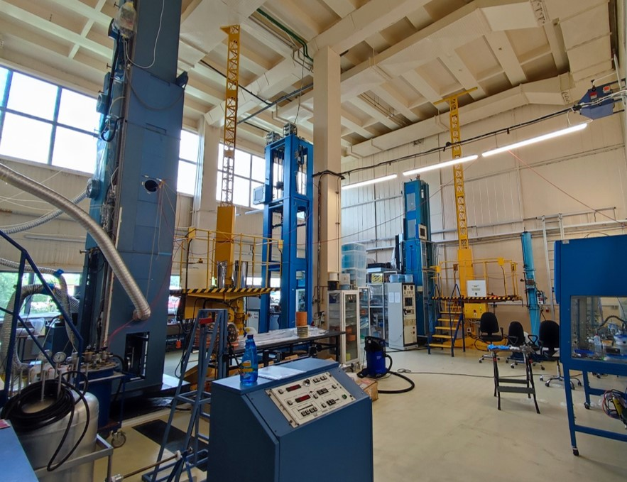
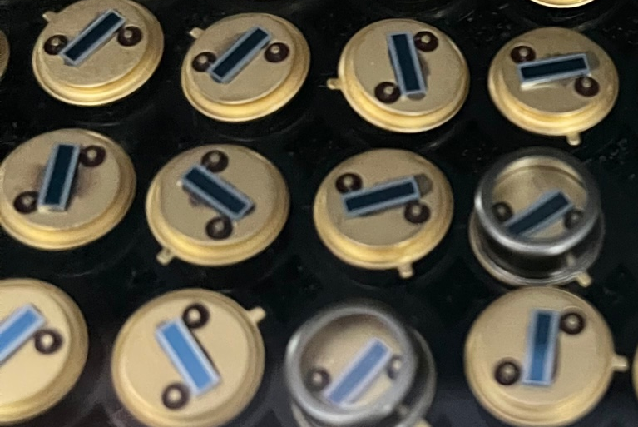
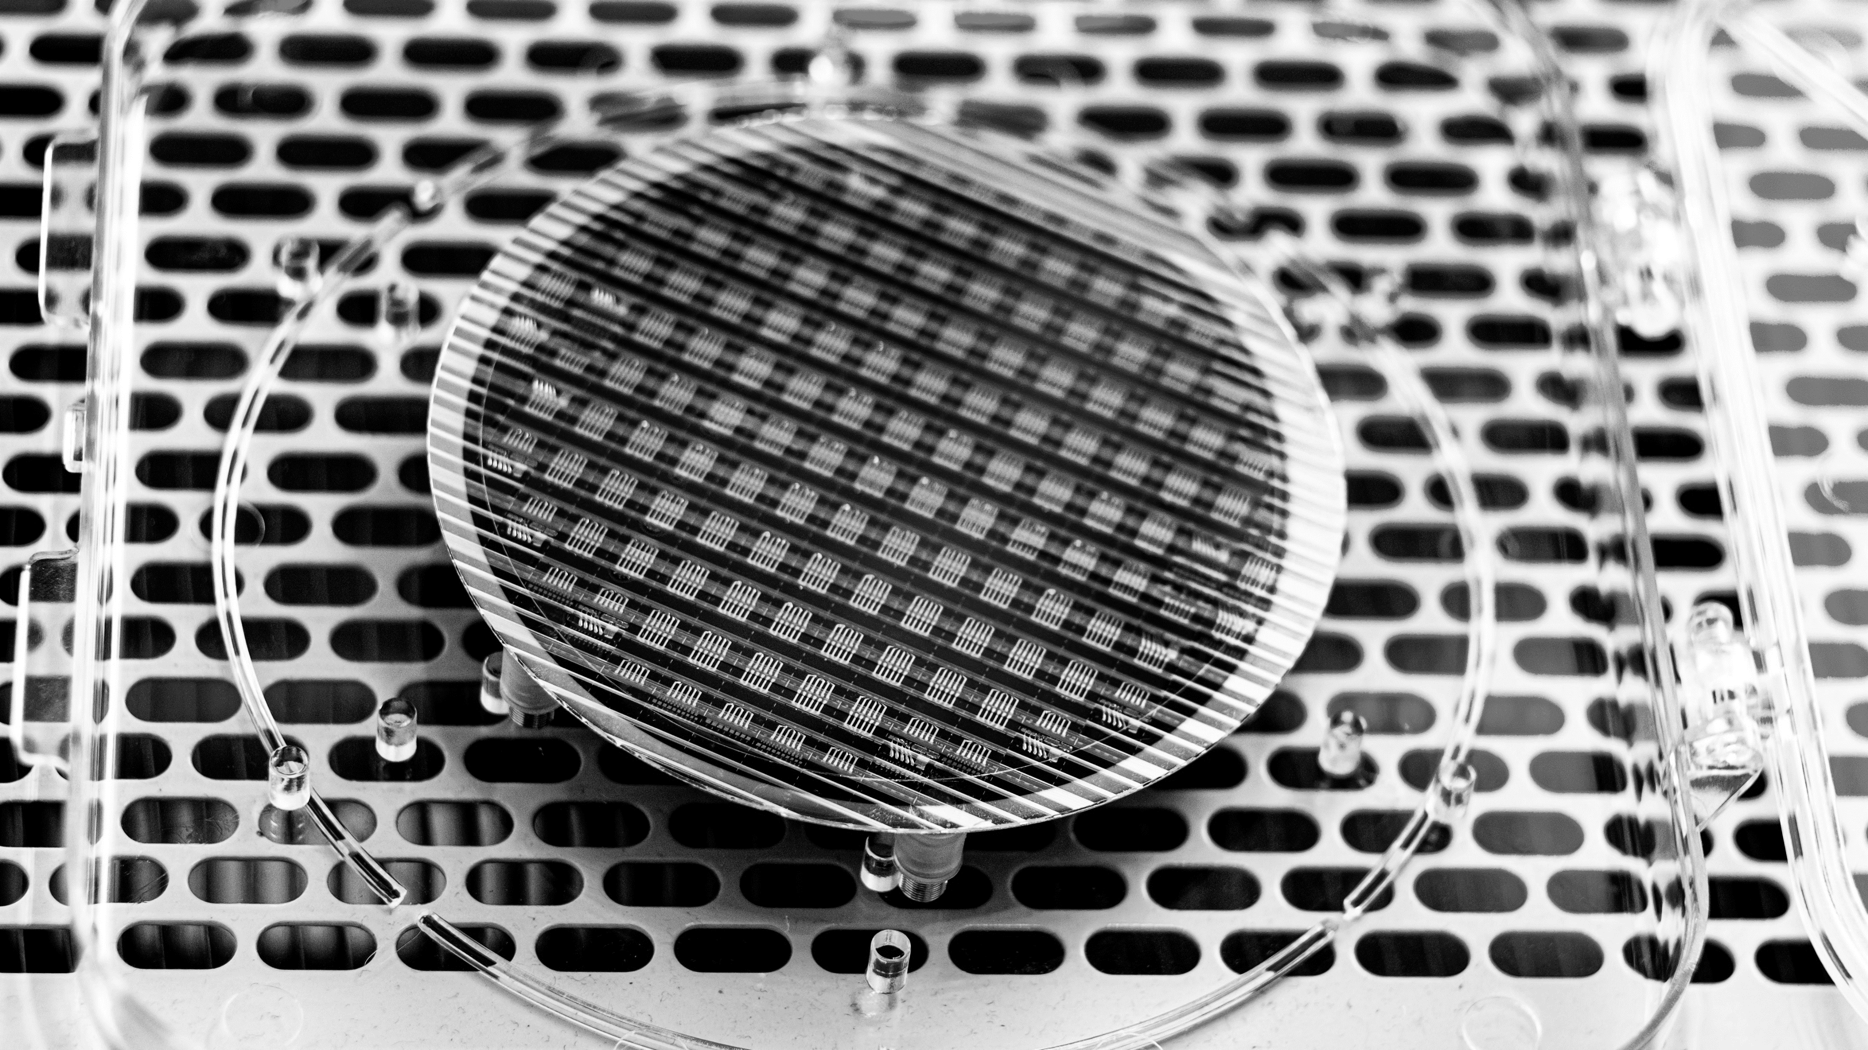
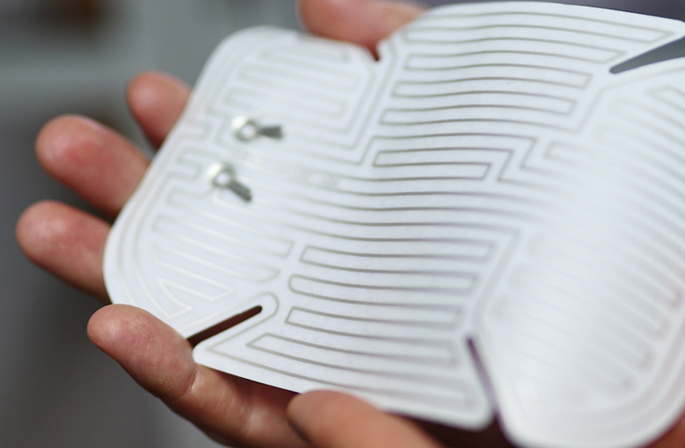
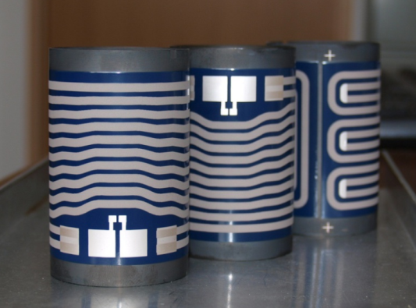
Łukasiewicz – Institute of Microelectronics and Photonics
Pictures

