Slide 1
Introduction to Czech Optical Cluster
online, 16 April 2024
Aleš Hála

Slide 2
Multisite Infrastructure
ELI is on the European Roadmap since 2006!
Investment has driven leadership in laser and photonics
Projected total peak power for high power laser systems operational and under construction is by far world-leading
ELI Facilities are introducing 3 @10PW and 6 @PW-class lasers,
Total investment ca 1 Billion EURO
ELI ERIC organization mandated to operate ELI Facilities

Slide 3
Secondary sources – beamlines of high energy photons, electrons, protons, neutrons, muons
Medical imaging and diagnostics, radiotherapy
New materials
X-ray optics
Plasma Physics, HED and High-field Physics
Fusion
Ultrafast physical processes
Chemical, medical and materials science analysis
Attosecond measurement techniques
Biological imaging technologies
Artificial photosynthesis
Nanoscience
Photonuclear Physics
High power laser system
Brilliant energy tunable gamma-ray beam system

Slide 4
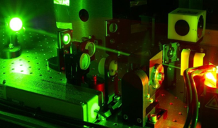
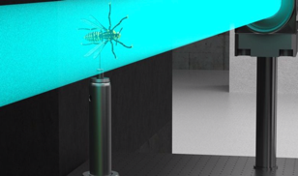
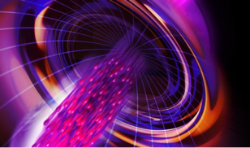
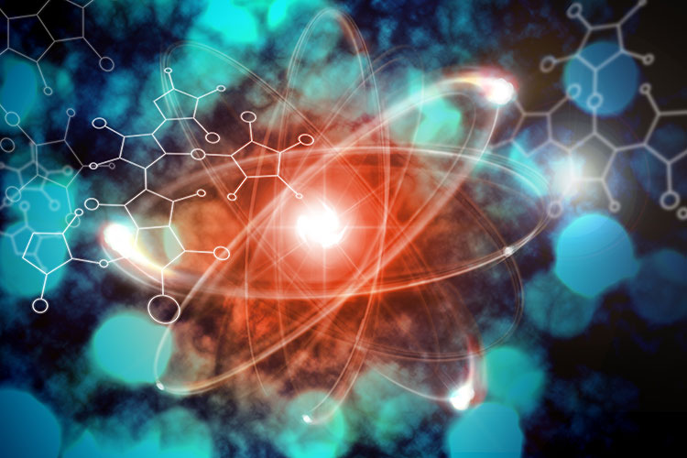
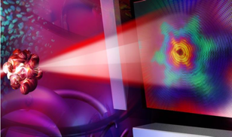
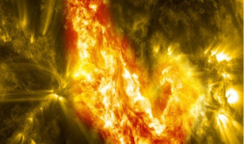
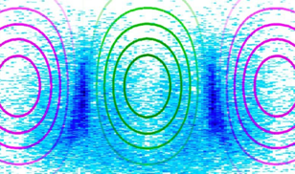
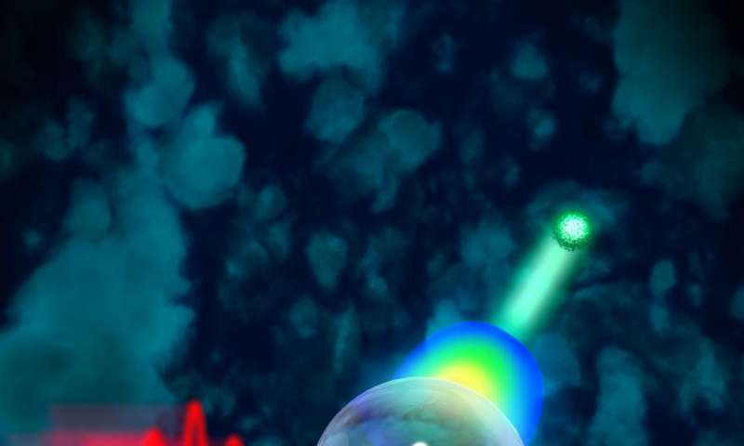
ELI Science Case
Particle Acceleration
250 MeV Ions, 10 GeV e⁻
Nuclear Physics and Photonics
Laser research
Soft to hard x-rays
Plasma Physics and High Energy Density, Astrophysics
Ultra High Intensity Interactions
High-field physics and theory
Material Science and Biology
Ultrafast, attosecond dynamics
Notes:
The science case grothw up from the initial ideal covering the key topics where high power lasers has a potential to bring ground-breaking discoveries.
Laser research – to build and furter push the technology limits
Particle Acceleration – a very atractive concept at that time to develop compact schemes – that comparing to the convensinaly RF accelerators could fit into 10x smaller envelop.
Structural dynamics – capability to obser ultra fast processes – chemical reactions, elctrons in movements.
High energy density physics – to support the concept of laboratory astrophysics, fusion research
Photo-nuclear physics – as a new kind of physics enabled through multi petawatt laser, and
Ultra hgh intensity laser matter interactions – quantum electrodynamics QED, entering new so far undiscuvered reqimes of physics

Slide 5
ELI ERIC is open to the world A user facility with three access modes
Excellence-Based Access Evaluation of proposals by international peer-review panels. Results of experiments published and open.
Mission-Based Access Thematic research granted on the basis of scientific missions pursuing challenges. Proposals reviewed by international panels. Results published and open.
Proprietorial Access Paid access for industrial or other users. Results are retained by the user, consistent with ELI ERIC’s Data and IPR Policy.

Slide 6
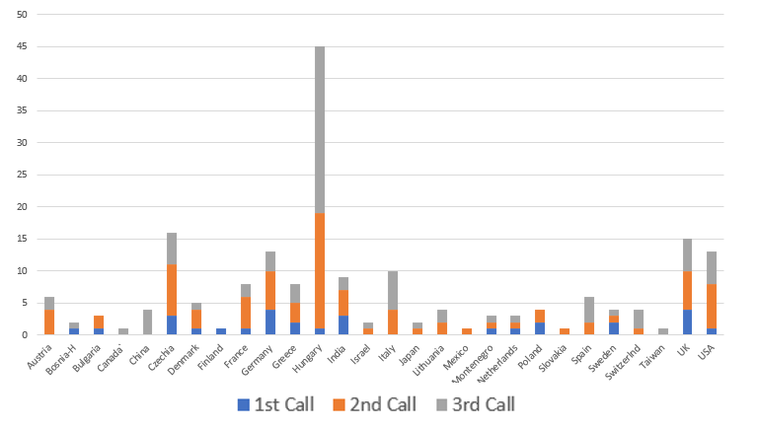
User Programme
The first 3 ELI user calls received 227 proposals from 28 countries
 | 1st Call | 2nd Call | 3rd Call
ALPS | 11 | 35 | 38
BL | 17 | 49 | 33
NP | 16 | 18 | 10

Slide 7
Czech Optical Cluster & ELI
Joint development of technologies & applications
User programme & Testing of newly developed solutions
Training of students, researchers and technicians (operating laser systems, beamlines, user stations, safety, etc.)
Creation of new technology supplier opportunities

Slide 8
Instrumentation development
Challenge: ELI Beamlines needs a clean and stable vacuum environment to place optical elements for experiments.
ELI Beamlines created a conceptual design based on optical paths and functional requirements.
STREICHER Pilsen, a company that manufactures custom vacuum chambers, made a structural analysis to predict chamber deformation and vibration stability of optical table mounted with manipulators and mirrors;
ELI Beamlines cooperates in the definition of the cleaning process for large UHV vacuum chambers that should be compatible with highly sensitive optical mirrors.
STREICHER Pilsen delivered this component to ELI Beamlines and used the know-how acquired to deliver large vacuum chambers with low outgassing to ELI ALPS and other customers.

Slide 9
ELI & Innovations
H+P Spectroscopy – use of a new method of UXV characterisation developer at ELI Beamlines Facility
Rigaku Innovative Technologies – prototyping of a new device used for laser-driven X-ray generation
Edwards Vacuum – testing of vacuum systems at ELI Beamlines Facility

Slide 10
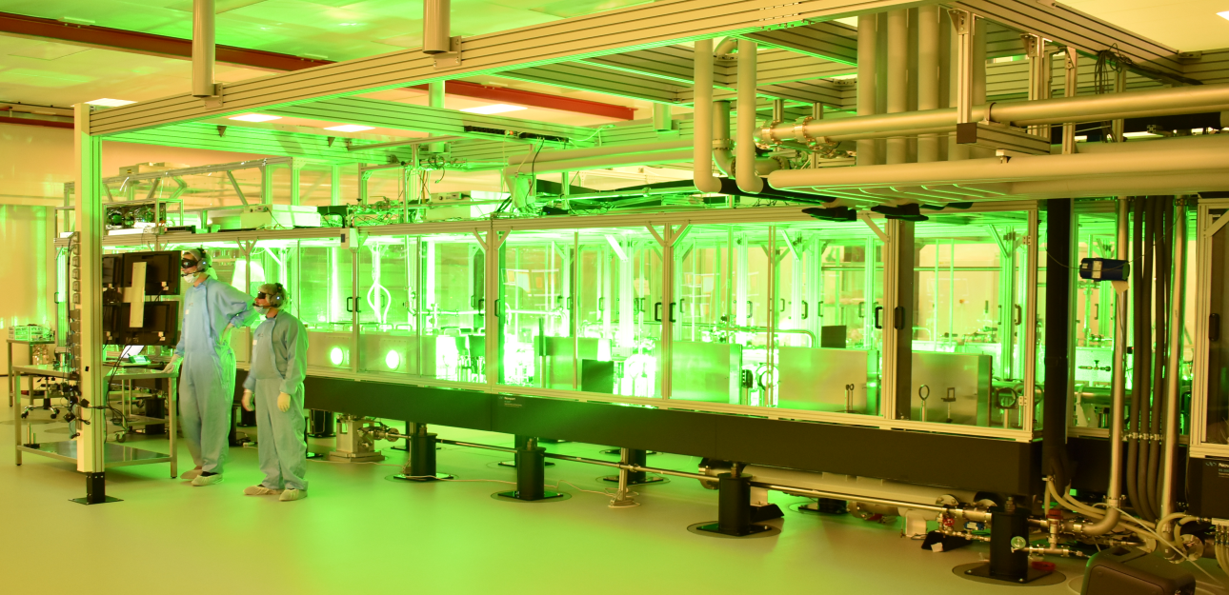
Training a new generation of laser experts
ELI welcomes doctoral and master level students from diverse fields
Over 40 students currently working at ELI doing research
Internship Programme for 30+ students annually
Ph.D. students sponsored by companies

Slide 11
The Czech Republic Contracted total value 2012 – 2022: 47 200 000 EUR
Vacuum systems & Components Optics & Diagnostics Electronics, Detectors & Others

Slide 12
Aleš Hála
Head of ELI Innovation Office
ales.hala@eli-beams.eu
+420 702 004 931

